Slide 1
#1 Digital Patient Conversion Platform
Secure better patient relationships
Be Found. Acquire. Engage. Delight.

Slide 2
Ready to grow your practice?
Acquire new patients from your online presence
Modernize patient experience Retain existing patients
Amplify the value of existing technology investments Less busy work, more time to focus on patients
Protect patients and staﬀ with a paperless, touch free experience

Slide 3
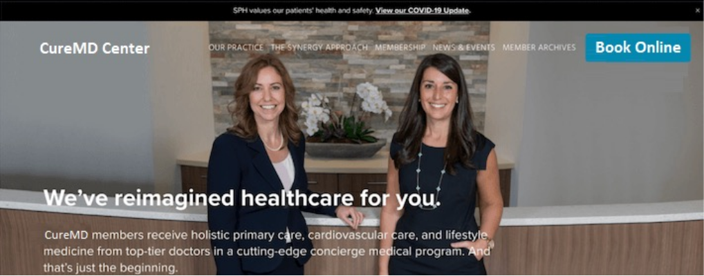
Online Booking
novelHealth Online Booking allows you to open scheduling access to your patients. Using the Book Online Button, patients can easily see your availability and book their next appointment. WHY SHOULD YOU GET ONE? - Get bookings when your office is closed. About a third of appointments made with the Book Online Button happen outside regular working hours. - Self scheduling & better. Patients can see your available time slots and book appointments – without the hassle of returning email or calls. And if you’d like to manually review before confirming appointments, turn that setting on – its’ easy. - Reduce dependence on staff availability. Check insurance eligibility, pre-screen patient’s visit eligibility and even collect copay/visit fees online.
Easy Booking. Anytime. Right From Your Website.
Practices see an average of 27% more new patient bookings after adding the Book Online button.

Slide 4
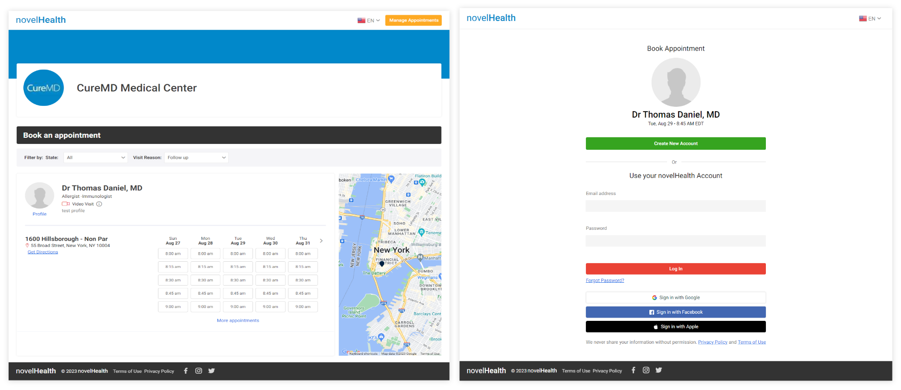
Online Booking Workflows

Slide 5
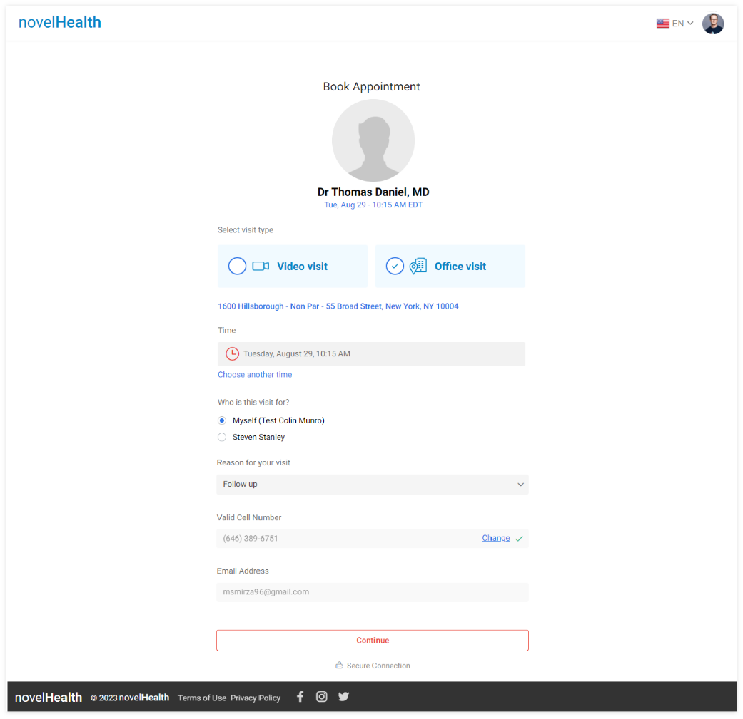

Slide 6
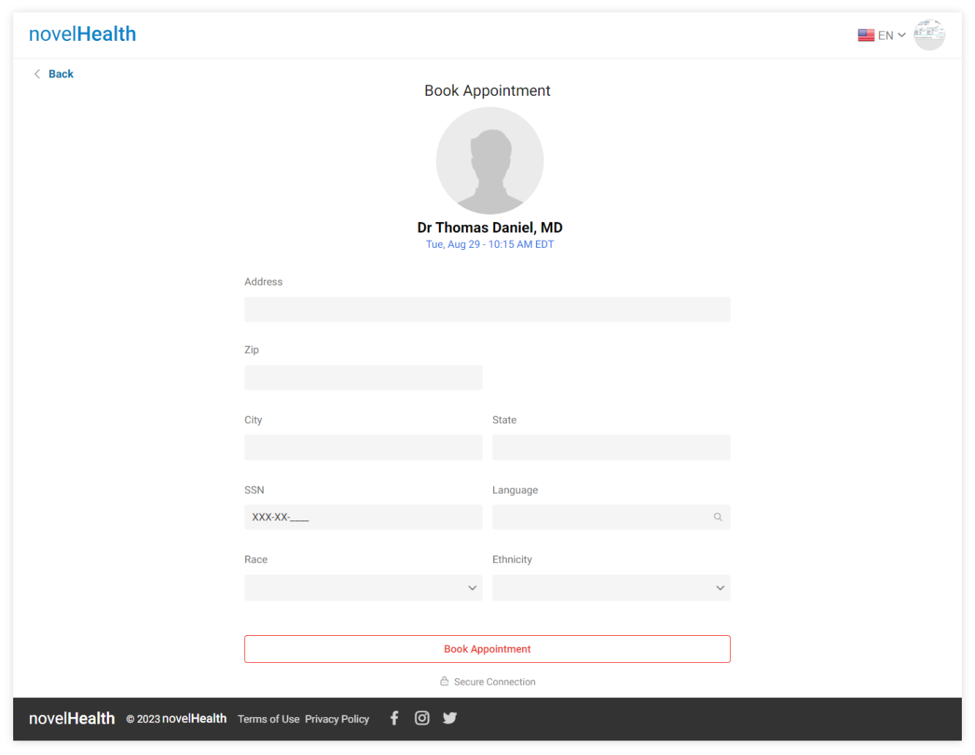

Slide 7
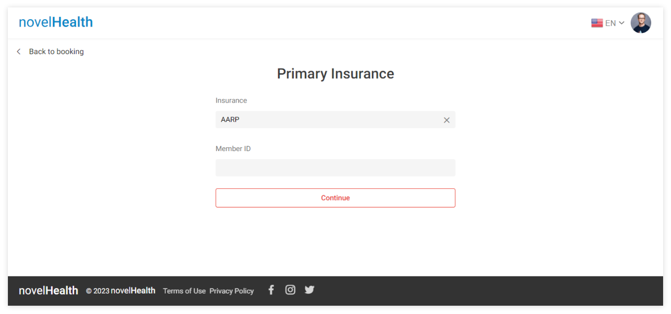

Slide 8
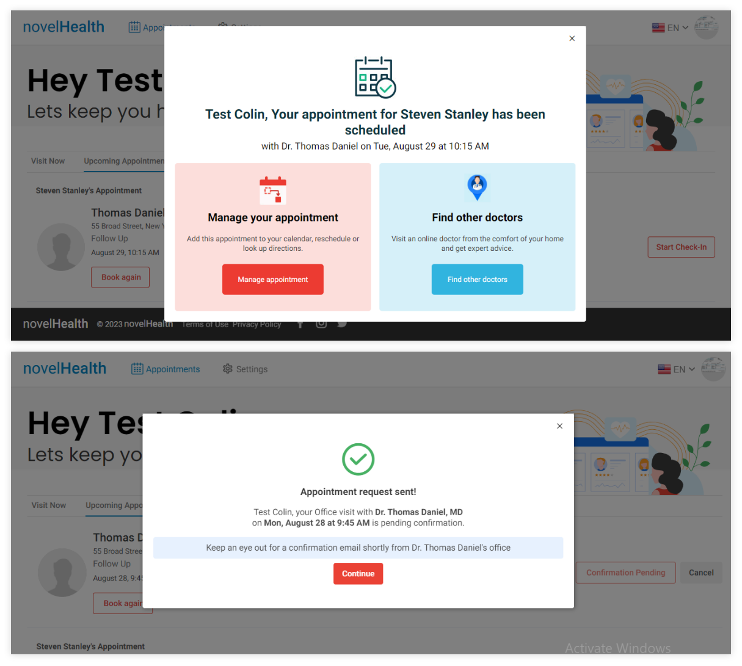

Slide 9
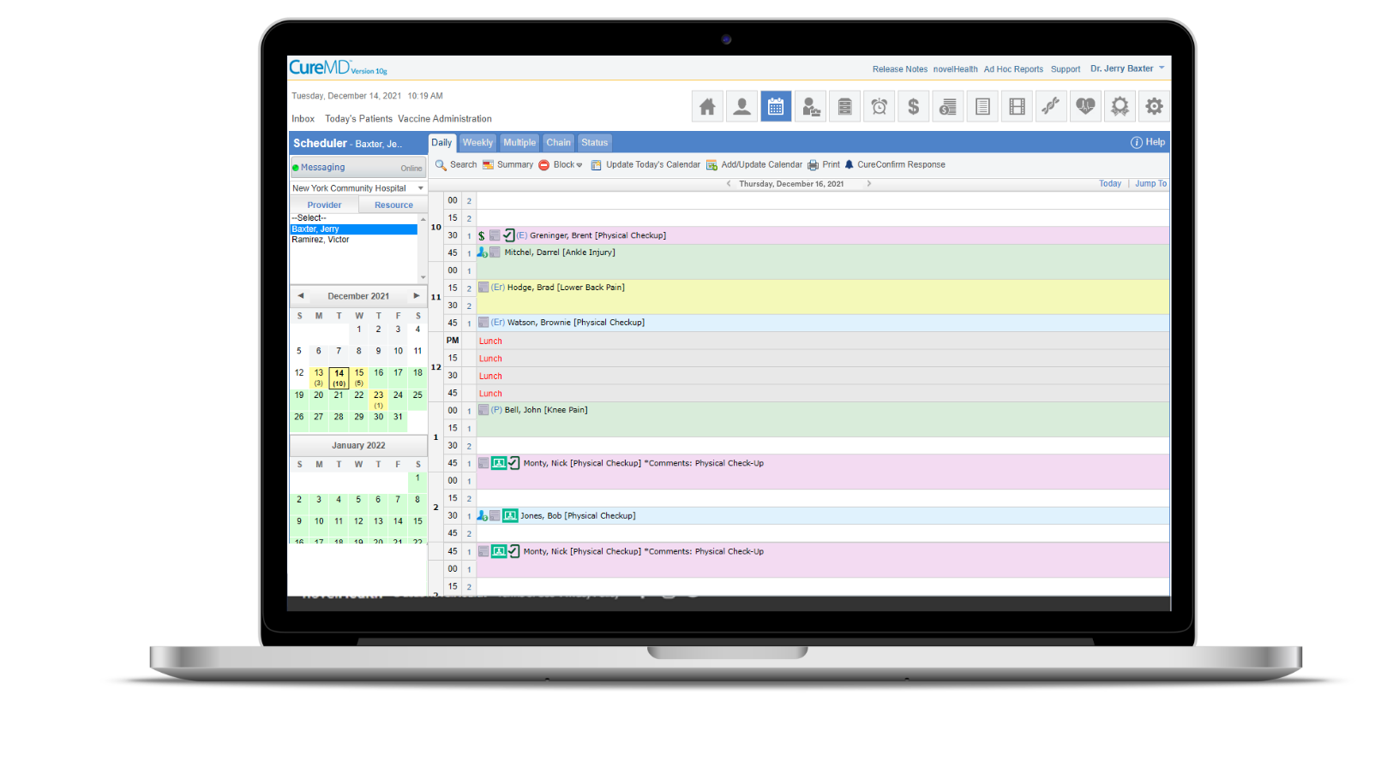
New Appointment Synced with CureMD Scheduler

Slide 10
Automate Your Front Oﬃce
Digital Check-In
A safe, convenient and configurable check-in experience for patients and staff. The workflow begins through a simple text message with a secure link to the check-in process. No app download required.
80% of patients would switch providers for greater convenience.
Give your patients a secure, easier way to check-in online, on their time, from any device. It’s safe, convenient, and easy to use — for patients and your front desk.
With novelHealth Contactless
Check-In, patients can:
Verify address and personal details
Scan insurance cards and licenses
Confirm insurance coverage
Sign consent forms
Make payments (co-pays, deductibles, balances)
Save card on file
Complete clinical intake
Provide medical history, allergies, medications, family, and social history etc.

Slide 11
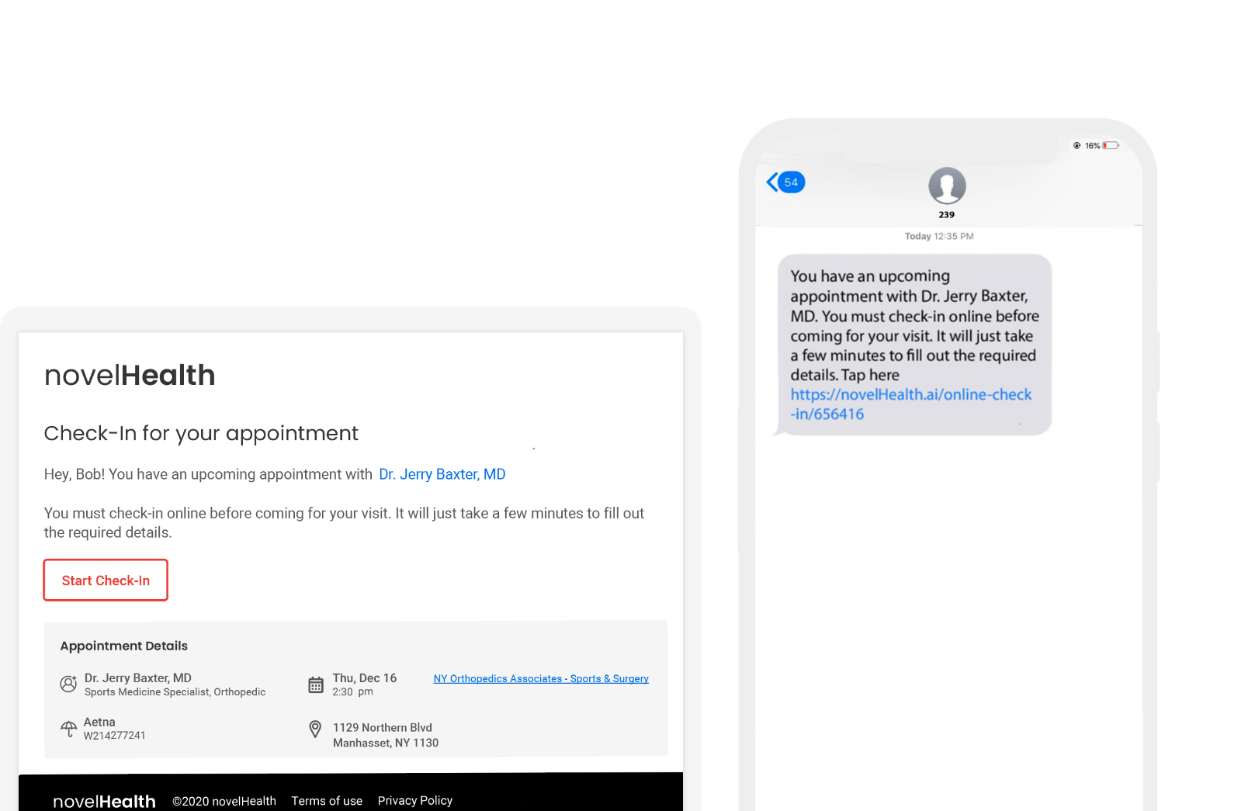
The patient receives a reminder to check-in, three days before his appointment

Slide 12
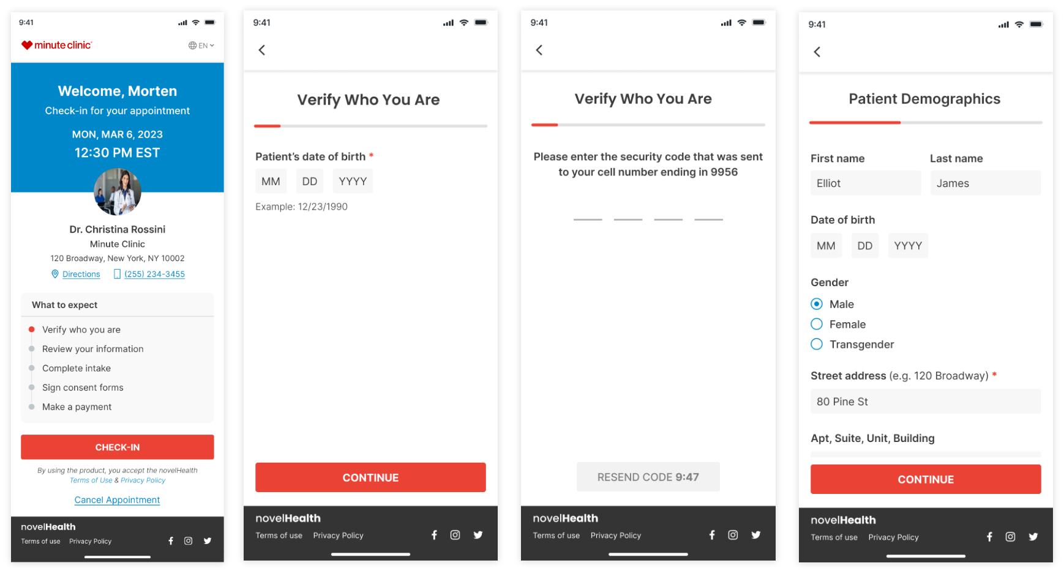
Digital Check-In

Slide 13
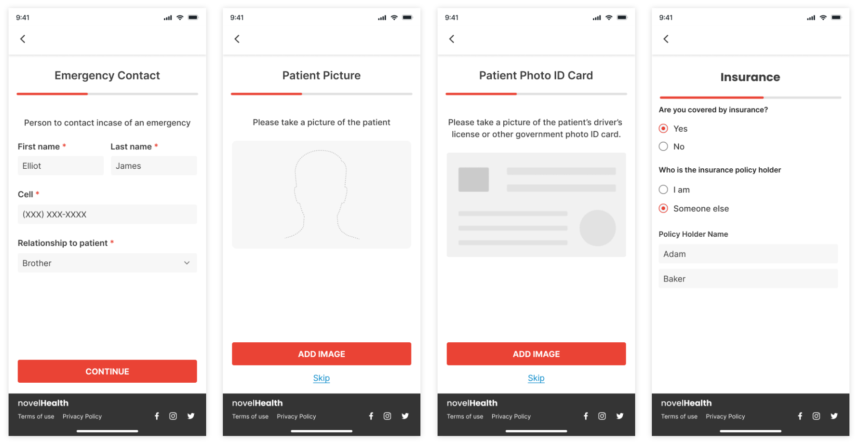
Digital Check-In

Slide 14
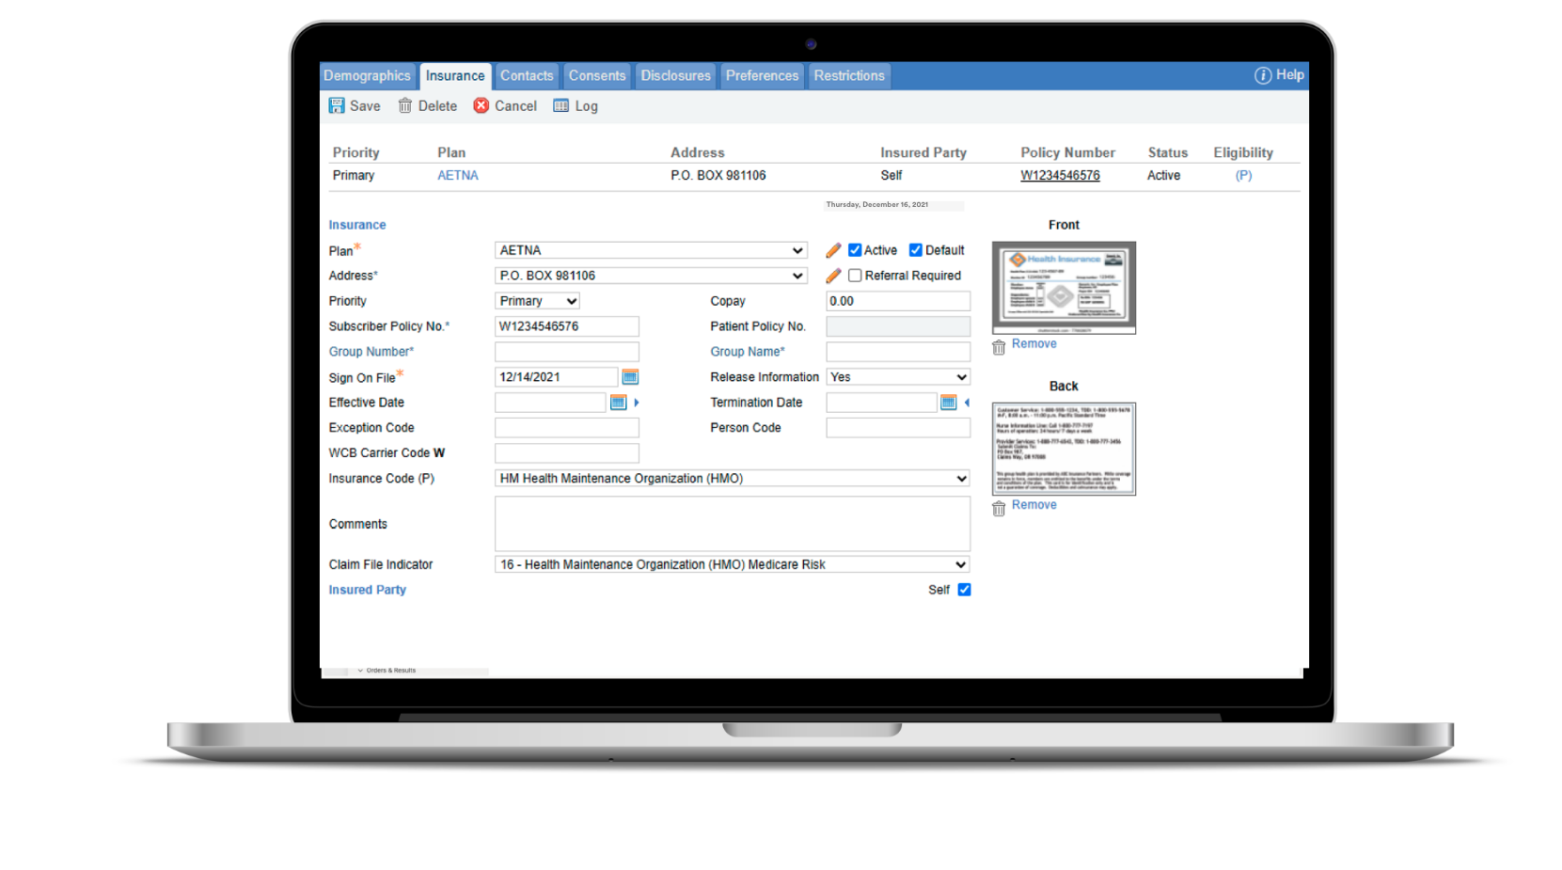
Insurance information synced with CureMD

Slide 15
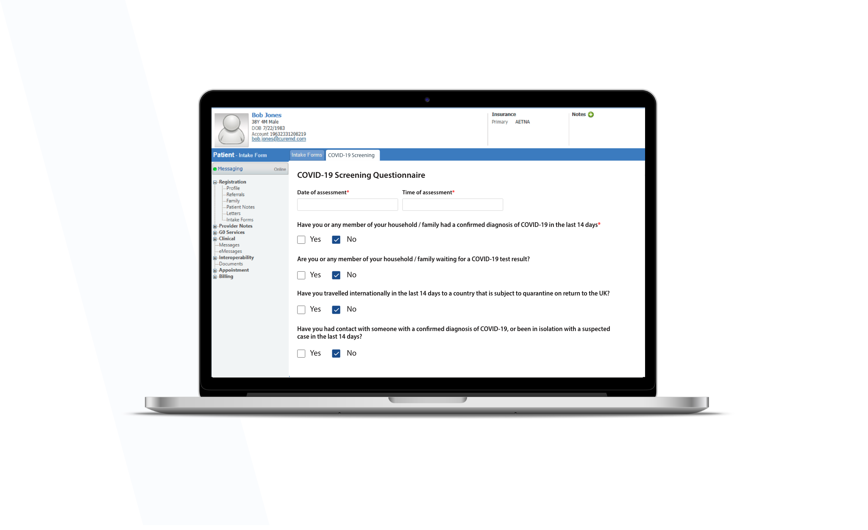
Screening forms synced with CureMD

Slide 16
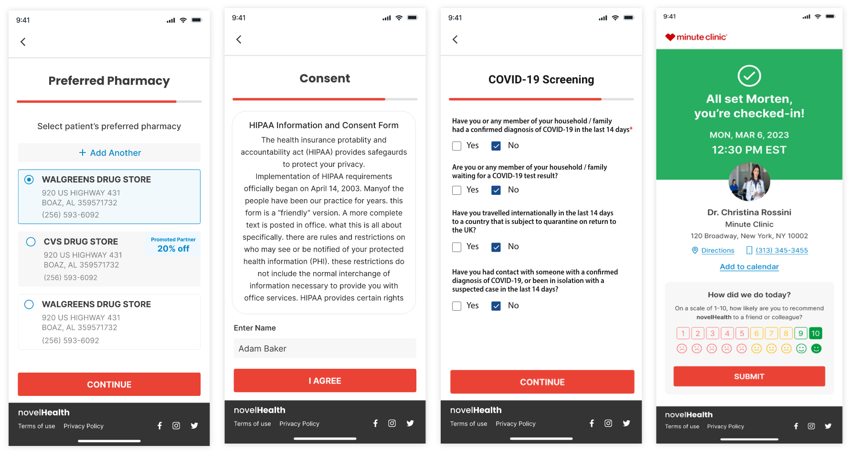
Digital Check-In

Slide 17
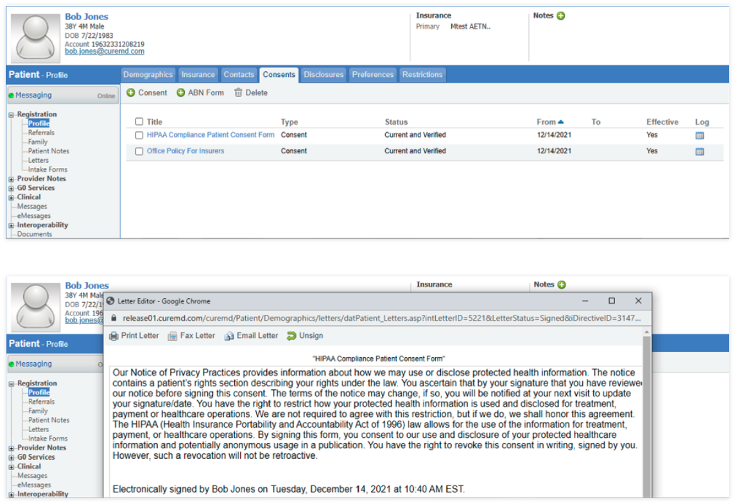
Consents synced with CureMD

Slide 18
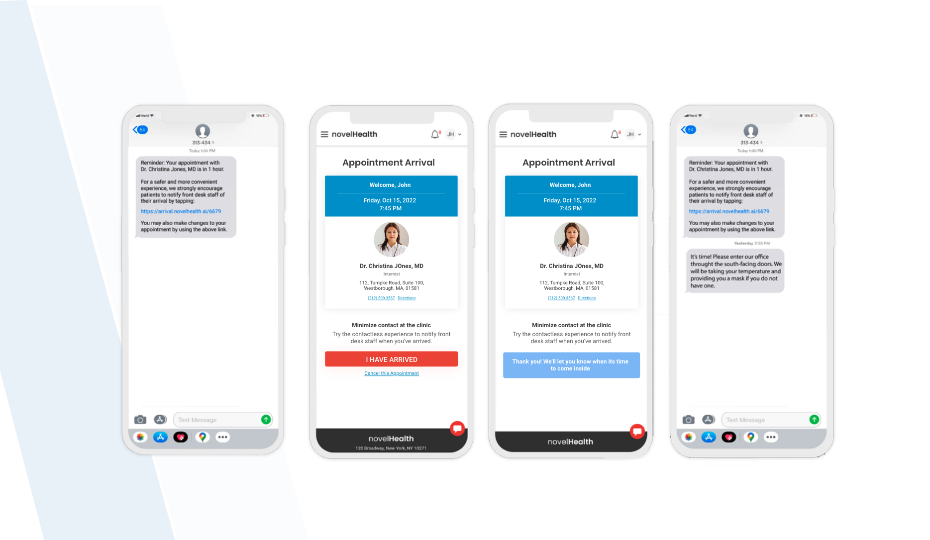
On the day of appointment..

Slide 19
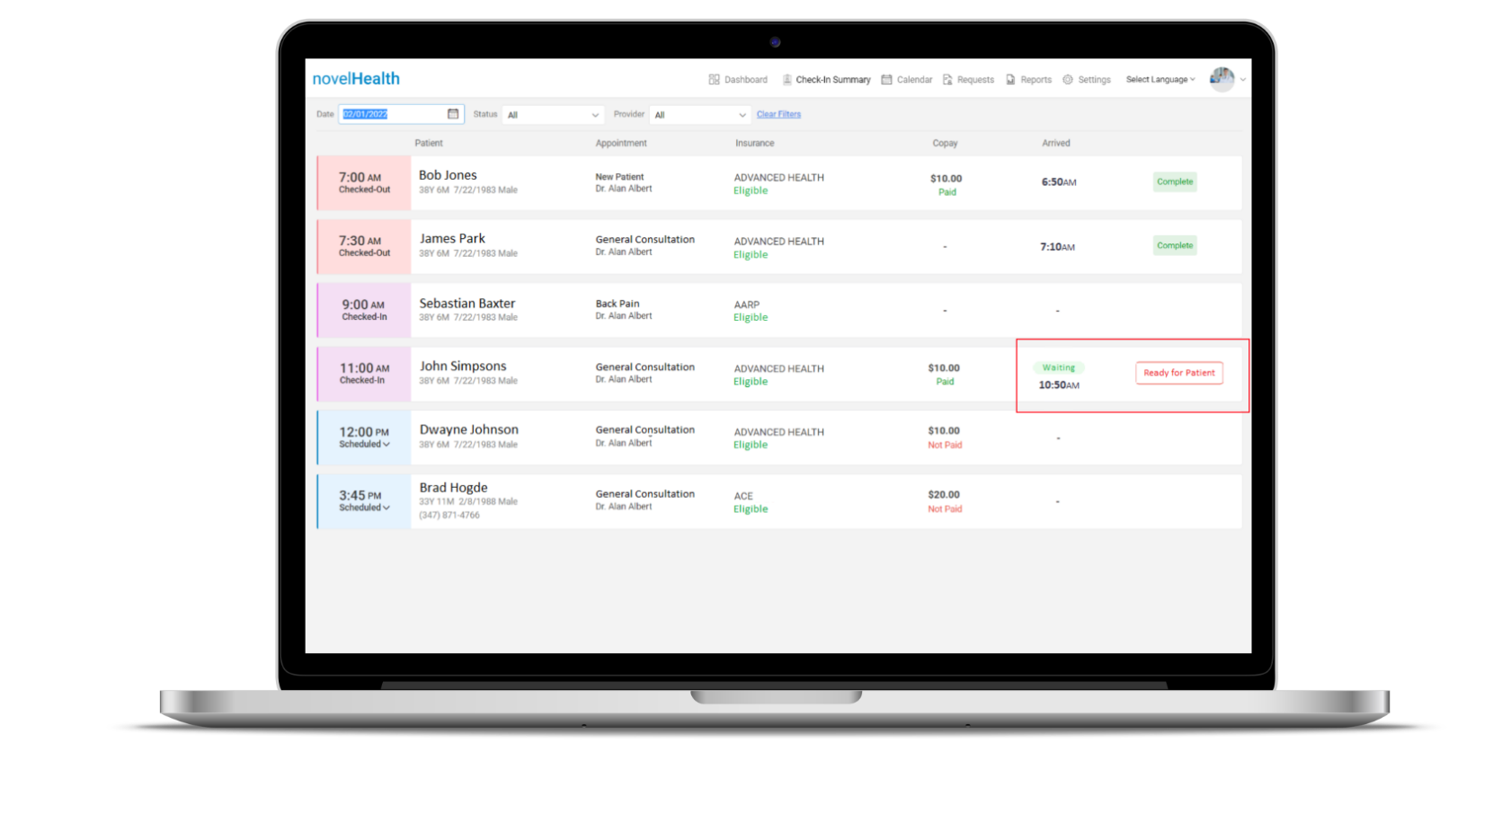
Arrival / Waiting time displayed on the practice dashboard

Slide 20
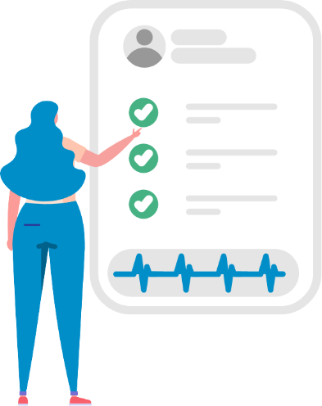
Patient Surveys
Easily accessible feedback helps care teams better understand and exceed patient expectations.
Send Surveys – Patient satisfaction surveys are sent automatically after every visit, via email and SMS/text.
Promote Sharing – Patients are invited to share their experiences on your practice website. Address Issues – All urgent patient responses are sent directly to you
for prompt management.
Maximize Responses – An eﬀective delivery cadence gives patients
multiple opportunities to respond.

Slide 21
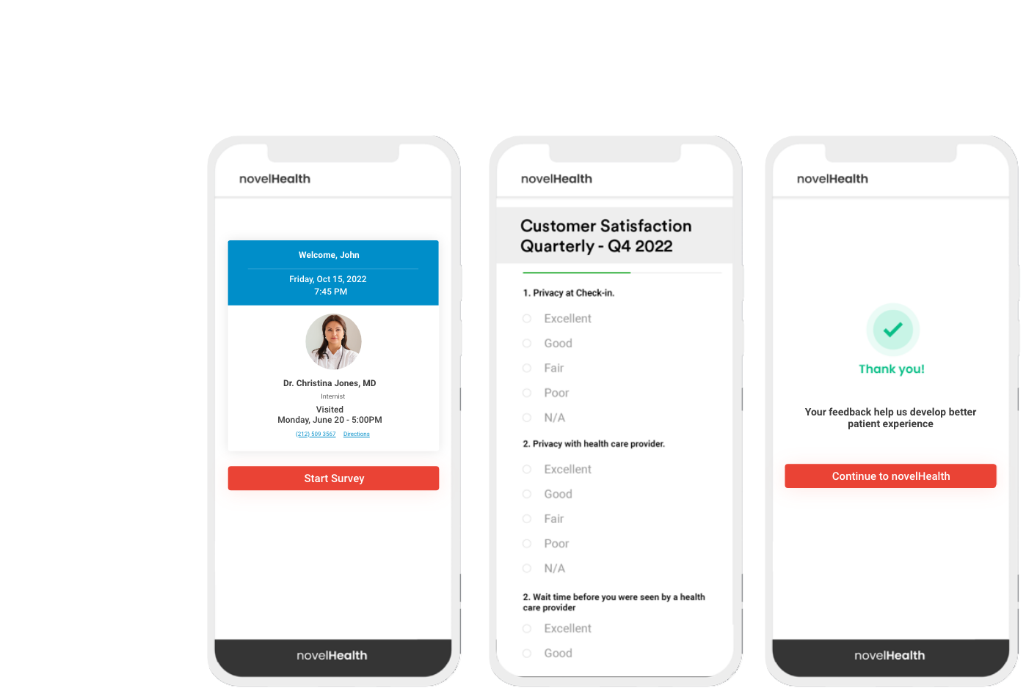
The patient fills out the survey questionnaire...

Slide 22
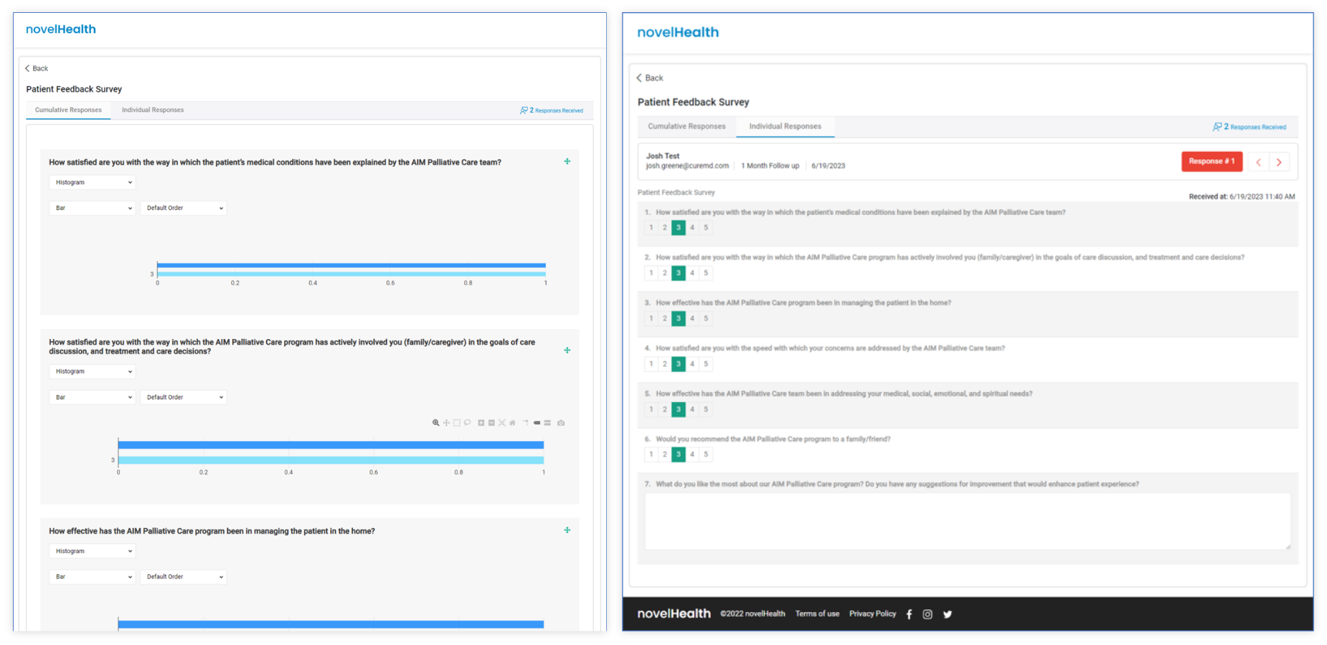

Slide 23
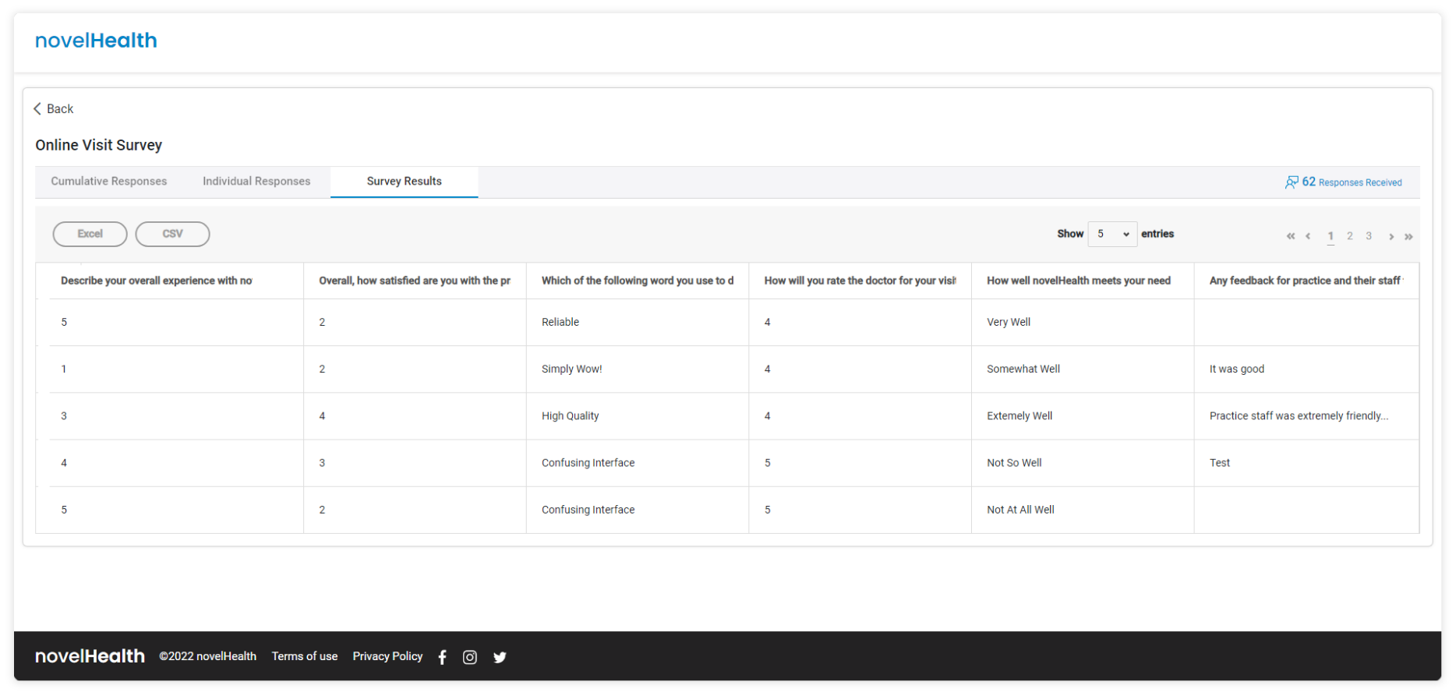

Slide 24
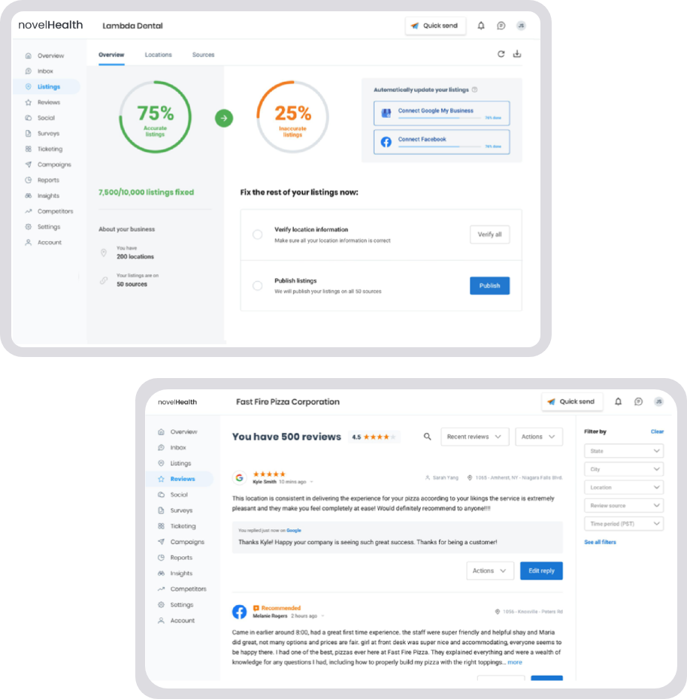
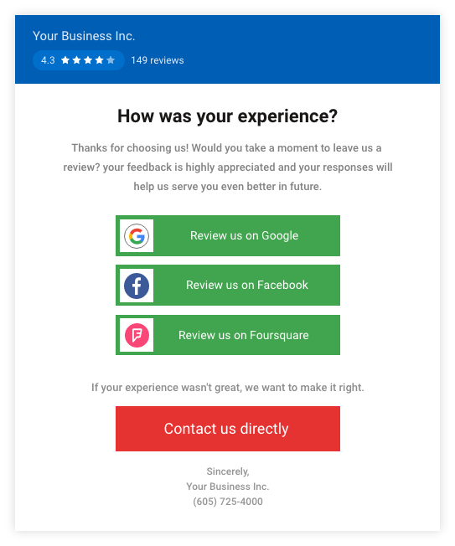
Reputation Management
Get more reviews automatically
Monitor all reviews in one place
Make reviews your competitive edge
Your Business Inc.

Slide 25
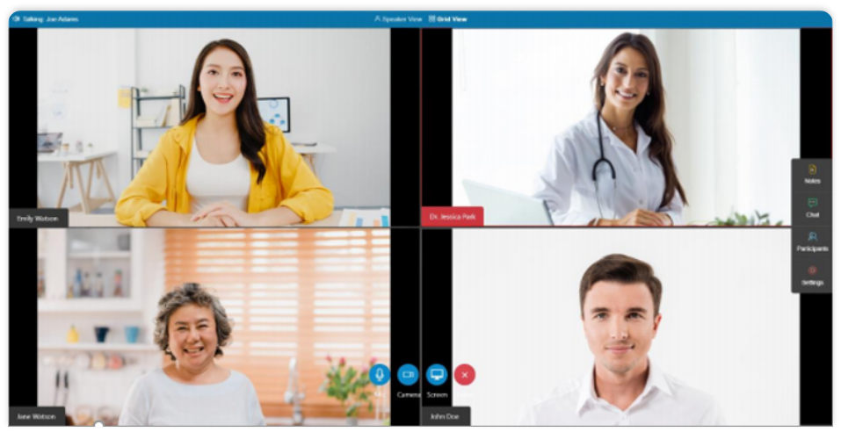
Telemedicine
Enable Virtual Care.
Telemedicine that works for all ages
- simple, secure and cost eﬀective.
No apps to download, no login required
HIPAA-compliant High-De nation Audio-Video experience
- Optimized for global use
Our telemedicine platform is designed for practices of all sizes - optimize patient experience and provider's bottom lines. The solution integrates with any EHR with API - as well as in a stand-alone setting.
Provider sends a secure link to invite patients to their one-tap-to-join virtual waiting room, including online check-In, payment collection and documents the session notes.

Slide 26
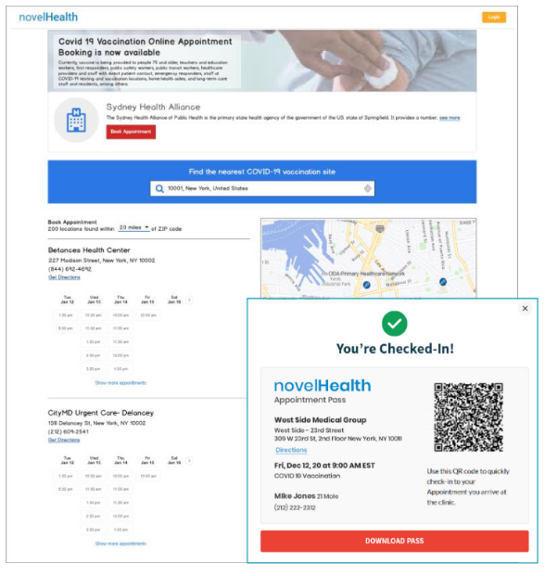
Fast, Flexible & Secure.
Helps you quickly & securely roll out your vaccination program for COVID-19 and Flu
Mass Vaccine Management
Our solution helps governments, healthcare providers and organizations transform vaccination administration.
- Patient self-scheduling
- Vaccine administration & one-click
- Smart appointment con rmation & reminders
documentation
- Fast & streamlines virtual check-in
- Autonomous billing
- Vaccine eligibility & screening
- Outcome monitoring using surveys and so
- Waitlist management
much more!
- Automate patient intake for vaccine visits
including consents, questionnaires etc.

Slide 27
Upcoming Features

Slide 28
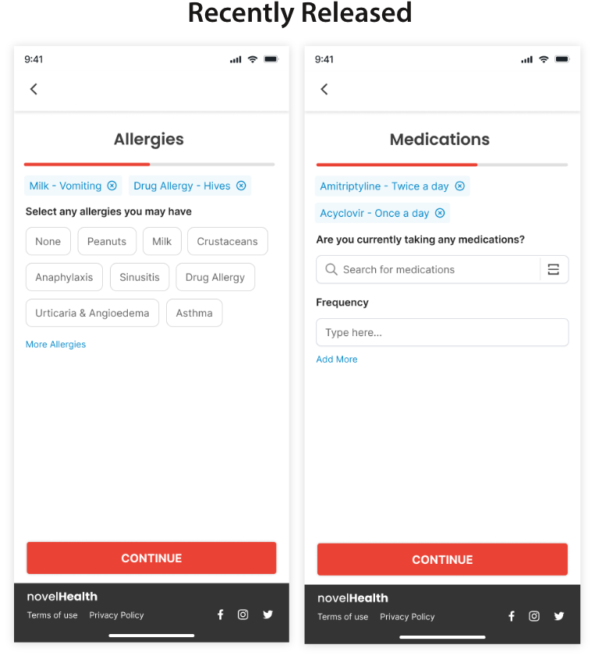
Patient Clinical Intake

Slide 29
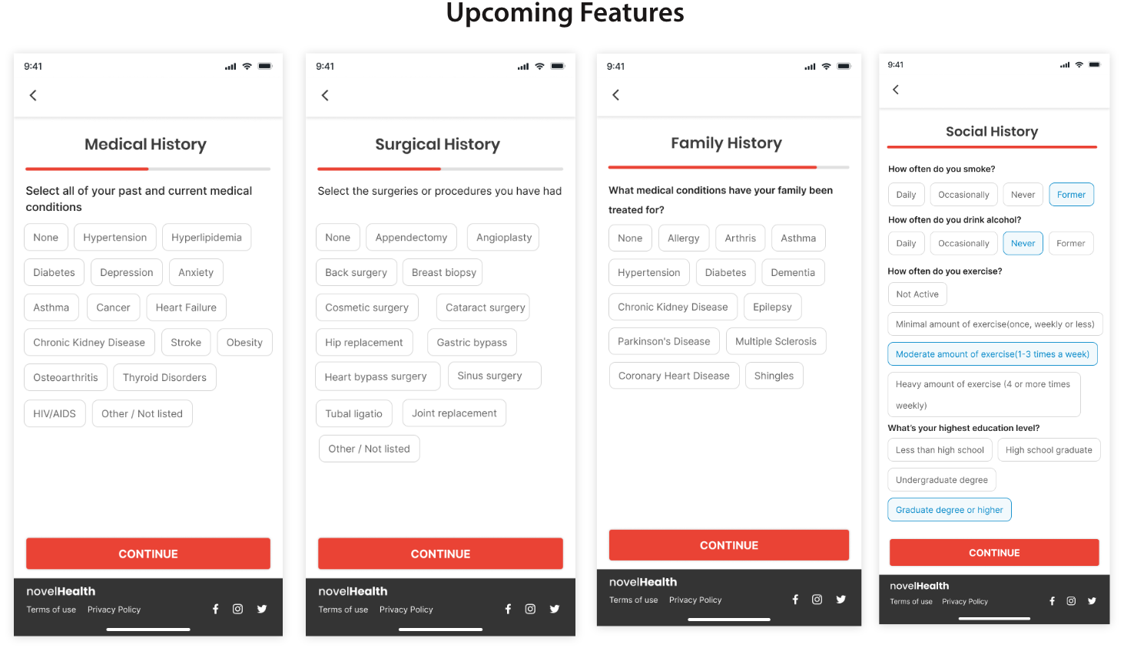
Patient Clinical Intake

Slide 30
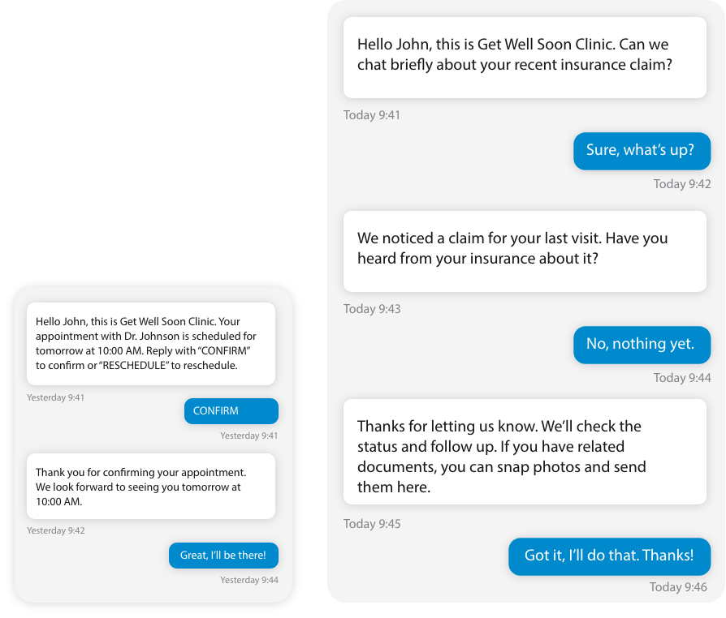
Interactive Patient Messaging
Connect with your patients through their preferred channel - text messaging.
Improve engagement and build stronger relationships.
Appointment Management Made Easy - Get patient con rmations for their upcoming appointment, and oﬀer them option to reschedule appointments via text - enhancing patient
compliance and reducing no-shows.
Instant Messaging Between Practice and Patient - Unlock the power of real-time communication. Patients can respond directly to messages, fostering a dynamic and personal connection.
Dedicated Practice Number - Establish trust with your patients using a dedicated mobile number. It’s your direct line for quick and reliable communication.

Slide 31
Thank You

